Slide 1
Code Intensive
Session 1

Slide 2
Learning Objectives
Java Fundamentals
in, out console
Java AWT
Window
Draw
Load and draw Image
Game Loop
Key Listener & Mouse Listener
Vector and Array List
Project Guideline:
Scrum board introduction (trello.com)
Version control (SourceTree + BitBucket)
Demo Hackathon(Gen1 + 2)

Slide 3
Demo Hackathon
Tank
Seven Sea
PvZ

Slide 4
Q?
Share code in your team?
Facebook
Google Drive
Dropbox
...
Git, SVN

Slide 5
Version Control
Why use “Version Control”?
BitBucket?
SourceTree?
To basic operations : pull, push

Slide 6
Java Fundamentals
This course is NOT “Game Development Course”?
We use Game for course because :
Logic of code
More object
Multi-Thread
Design Pattern
...

Slide 7
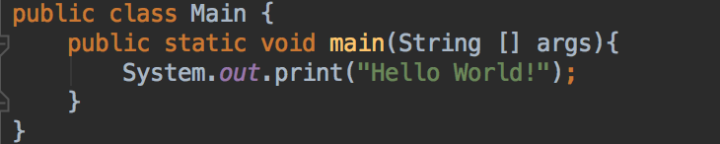
Main method
The start method of Java is ‘main’
Struct
Public static void main(String [] args){
//your code
}

Slide 8
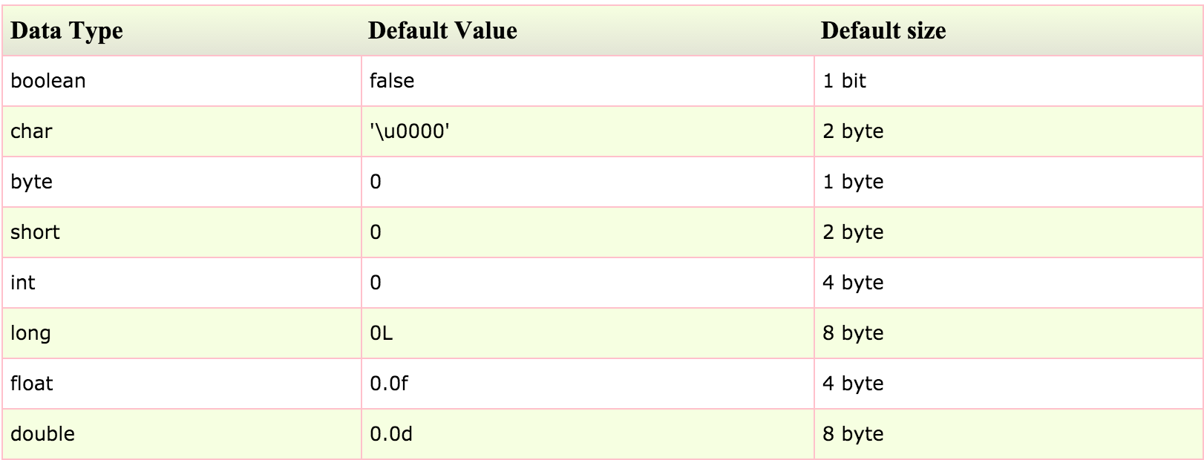
Data type
Notes:
hỏi đáp

Slide 9
I/O console
INPUT
Scanner
OUTPUT
System.out.print

Slide 10
AWT Window
Create new Window with Frame
Title
Size
Event click to Exit button

Slide 11
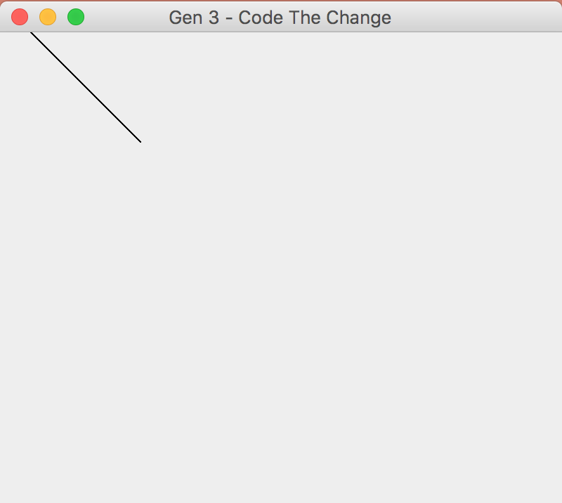
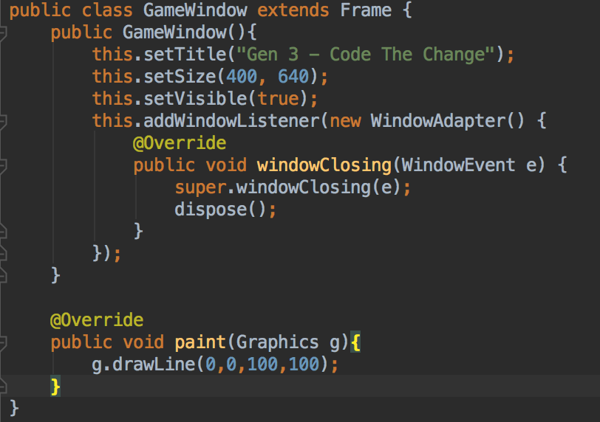
AWT Window
Draw method

Slide 12
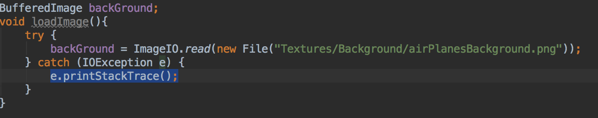
Load and Draw Image
Load Image

Slide 13
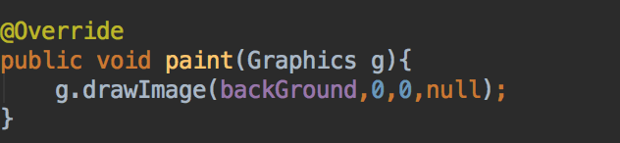
Load and Draw Image
Draw Image
Repaint

Slide 14
Key Listener and Mouse Listener

Slide 15

Move Plane by Key Event
How to move plane?
Position
X
Y

Slide 16
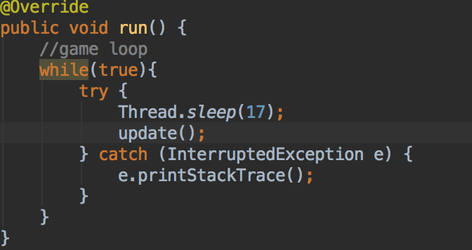
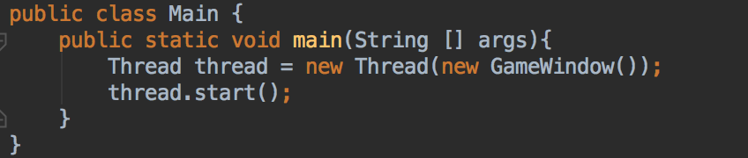
Game main thread and Game Loop
Game main thread?
Thread
Runnable
“run()” method

Slide 17
Game Loop?
Game Life Cycle

Slide 18
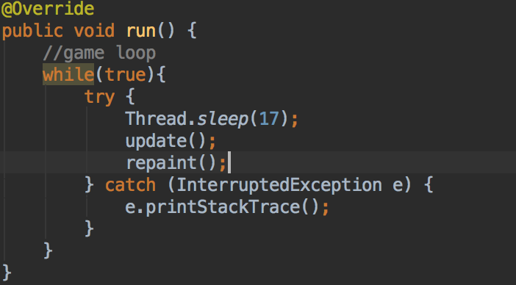
Game Loop

Slide 19
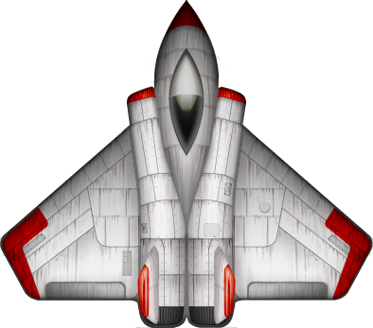


Assignment
Create another Plane move by Mouse?

